Slide 1
Matrimonial WebAPP (Progress Report)

Slide 2
Introduction:
Matrimonial Web Application is to provide Grooms and Brides with matchmaking experience by exploring the true partner.
User can get information regarding their dream life partner.

Slide 3
Purpose:
The main purpose of this application is to facilitate matchmaking to different people.
Which helps those users who have a certain criteria of qualities in mind to make online matrimonial easier.

Slide 4
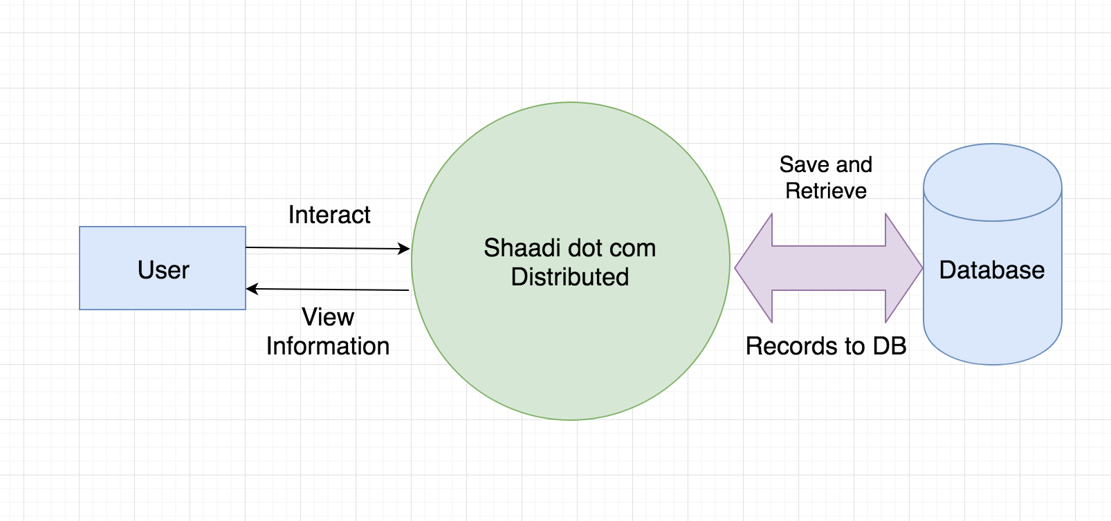
Diagram:

Slide 5
Scope & Objectives
This Application can be use by Every one.
Matrimonial website which will provide platform to a lot of Bride/Groom for finding perfect match.
There are different sectors like Registration, Partner Search, etc. So the Bride/Groom can get their interest for find their partner. Bride/Groom can directly search Partner according to their required criteria.
This application is specially designed for those who have problems in finding partner.

Slide 6
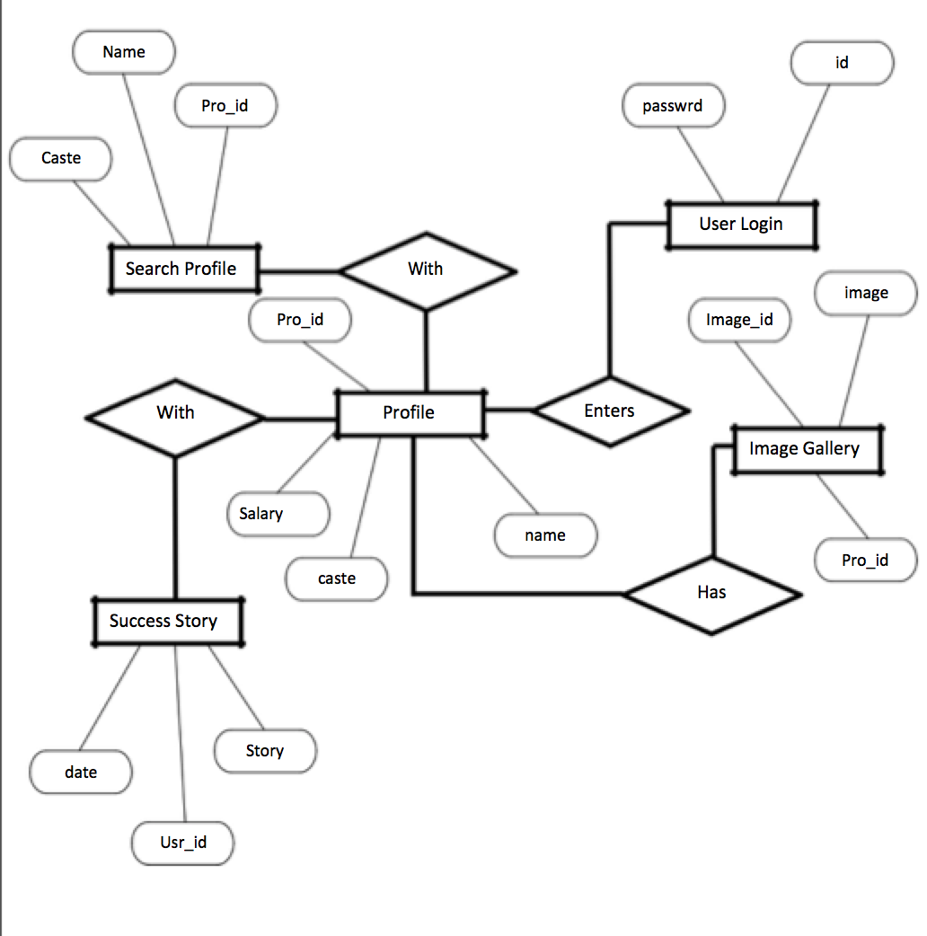
ERD(ENTITY RELITIONSHIP DIAGRAM):

Slide 7
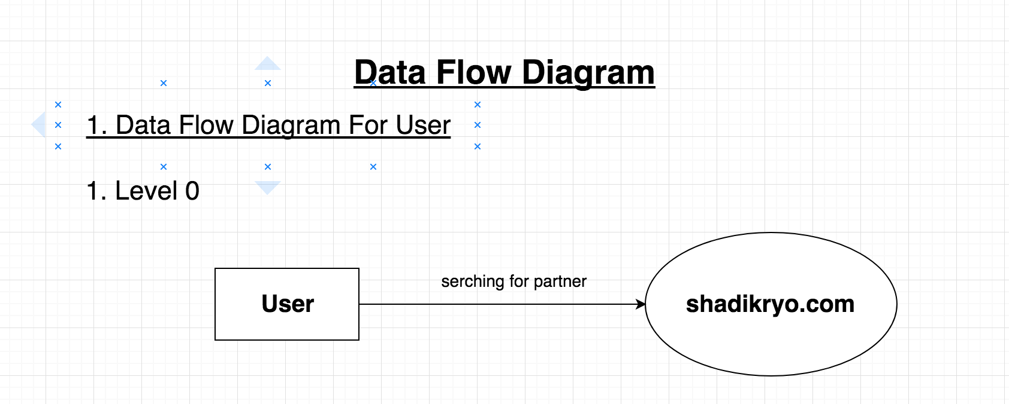
Data Flow Diagram:

Slide 8
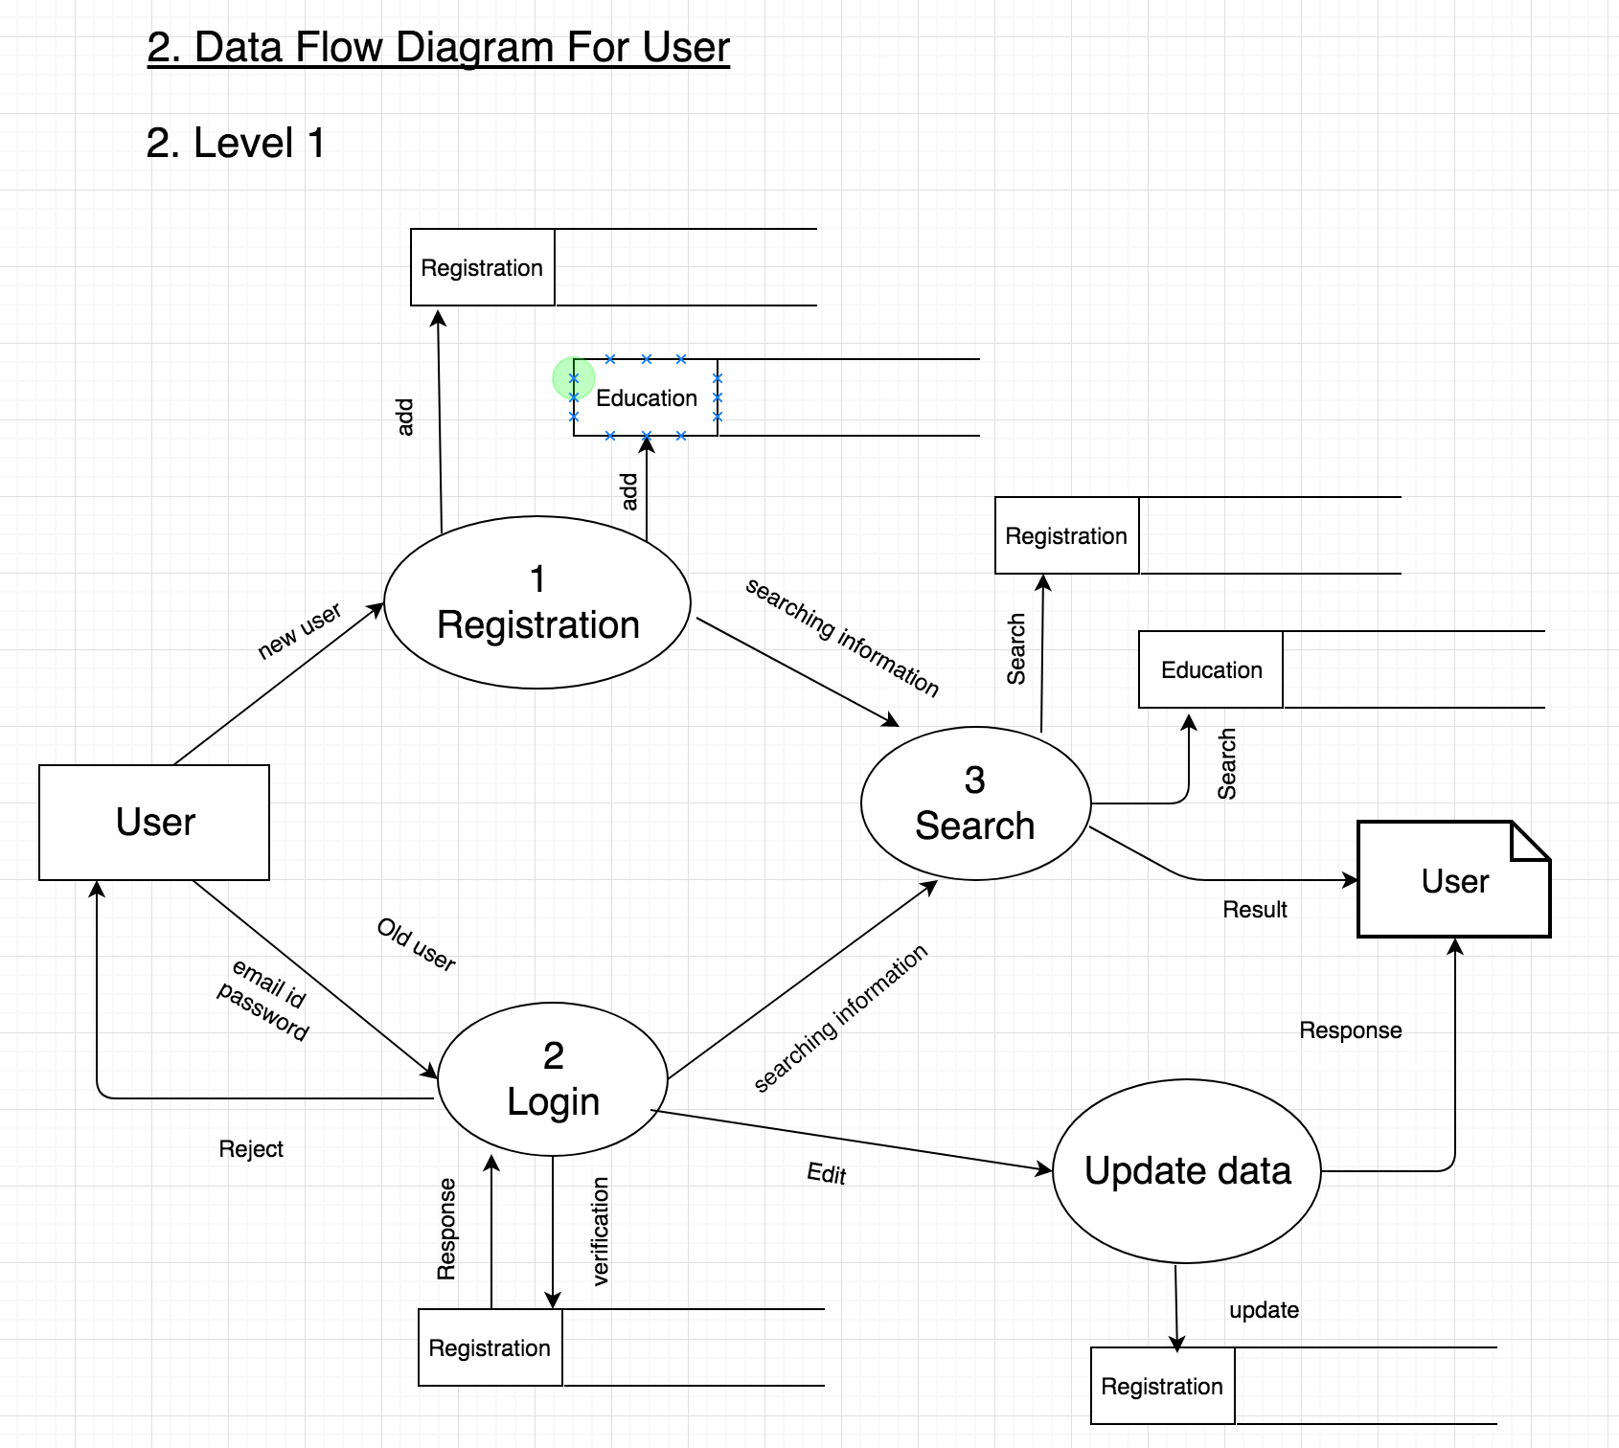

Slide 9
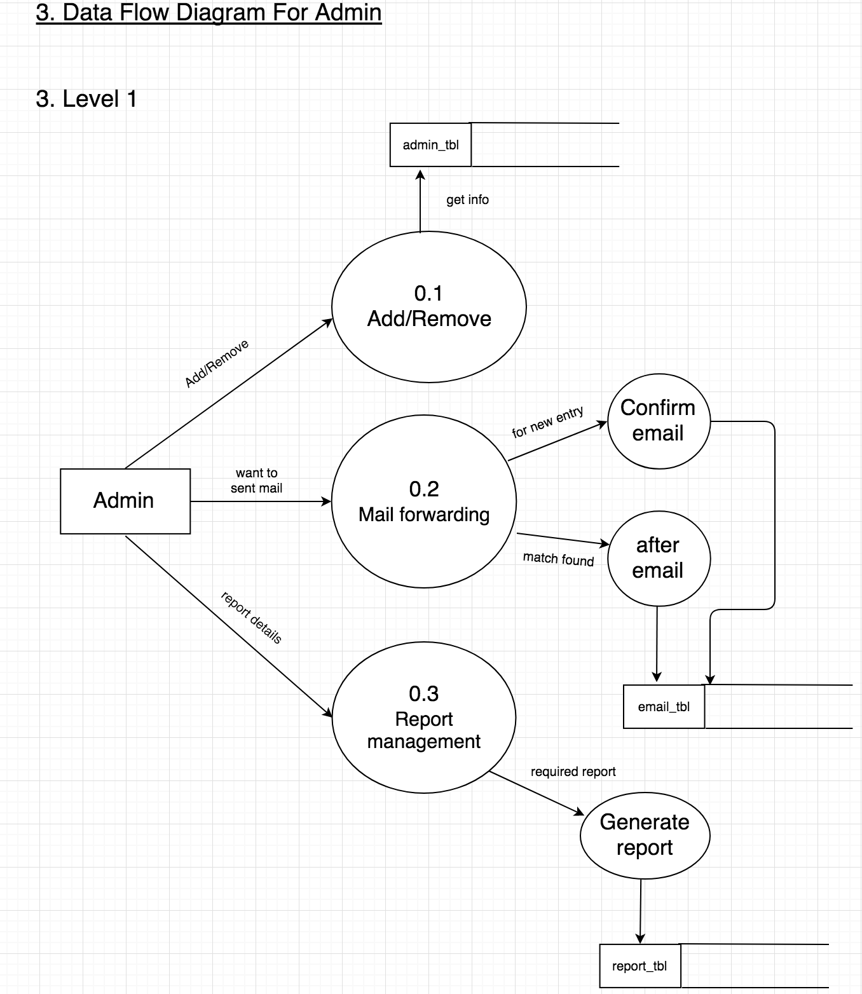

Slide 10
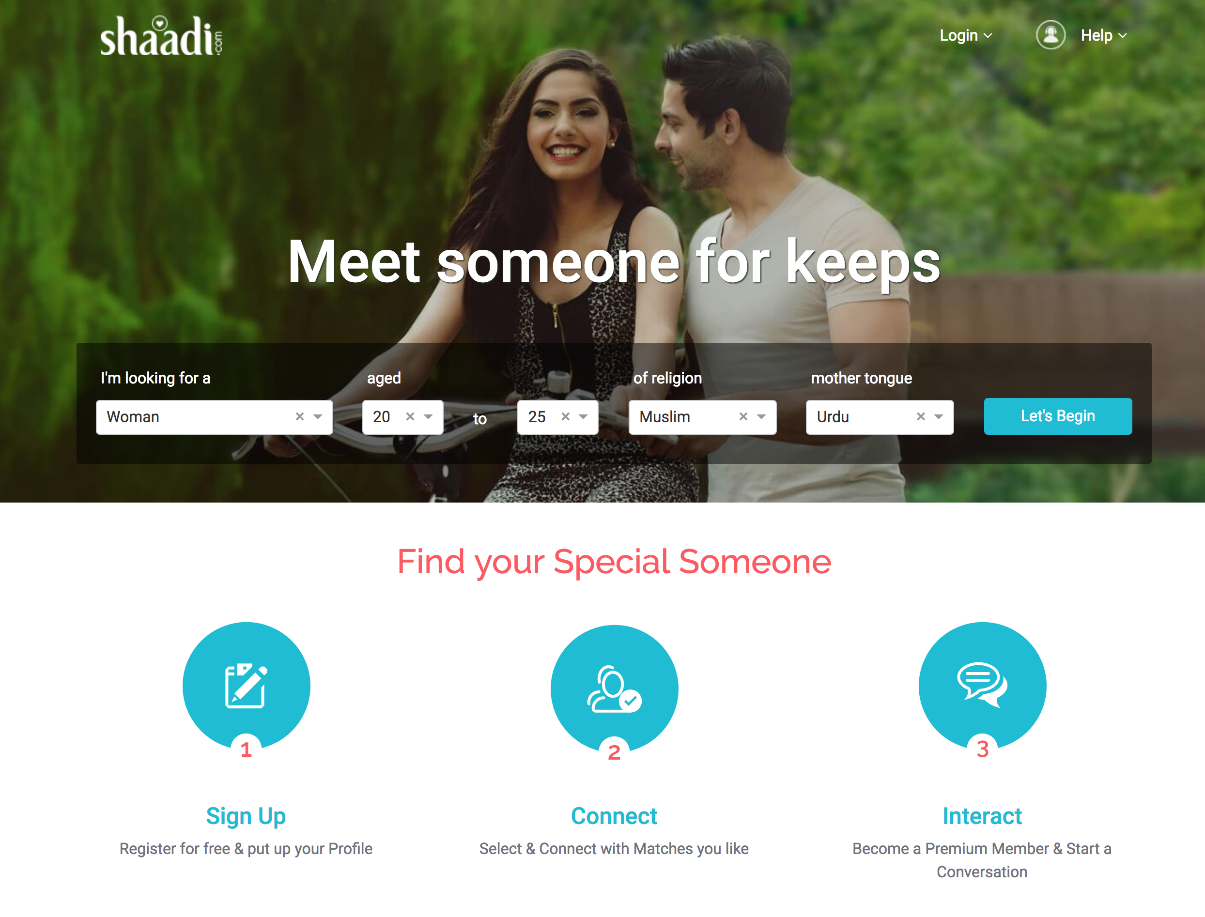
App Front End:

Slide 11
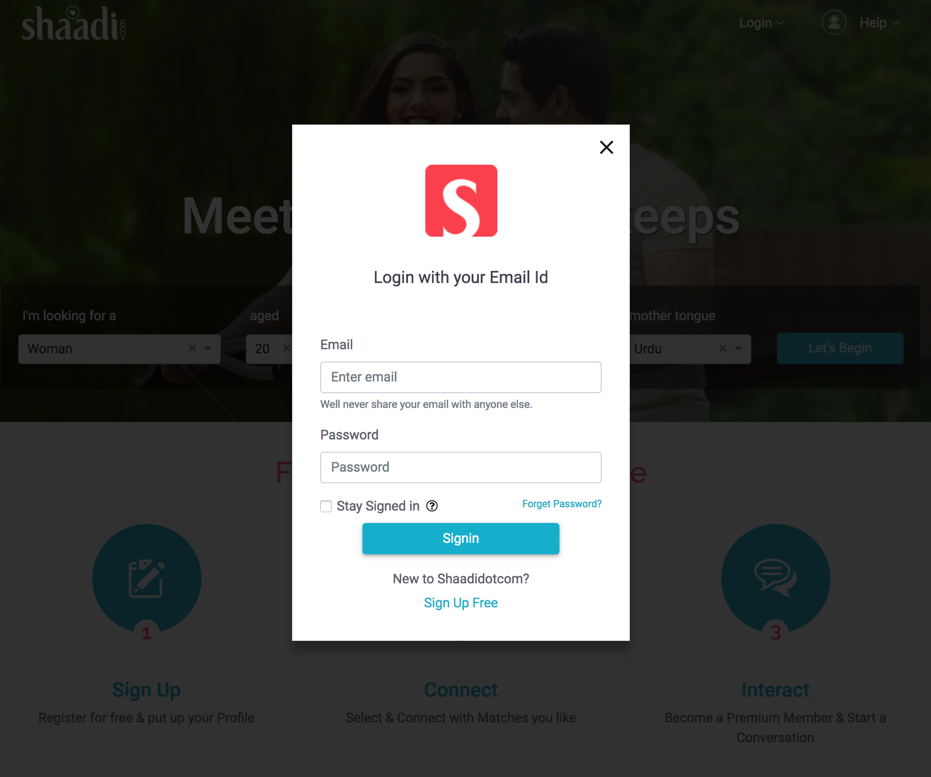

Slide 12
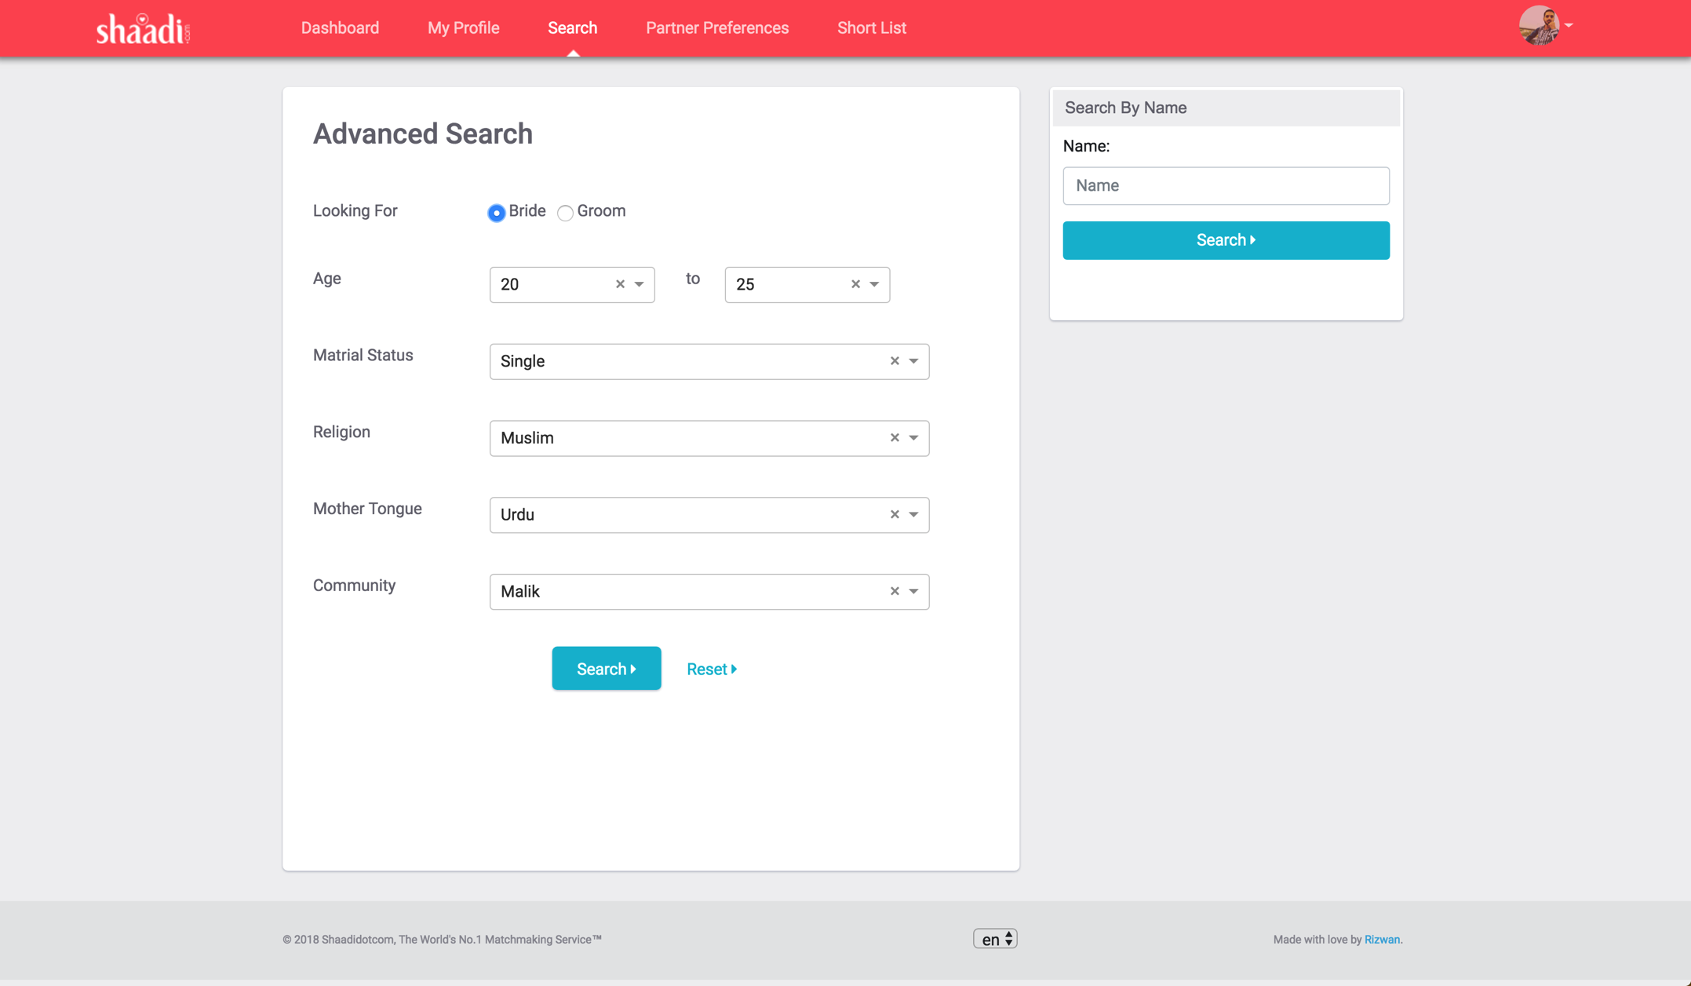

Slide 13
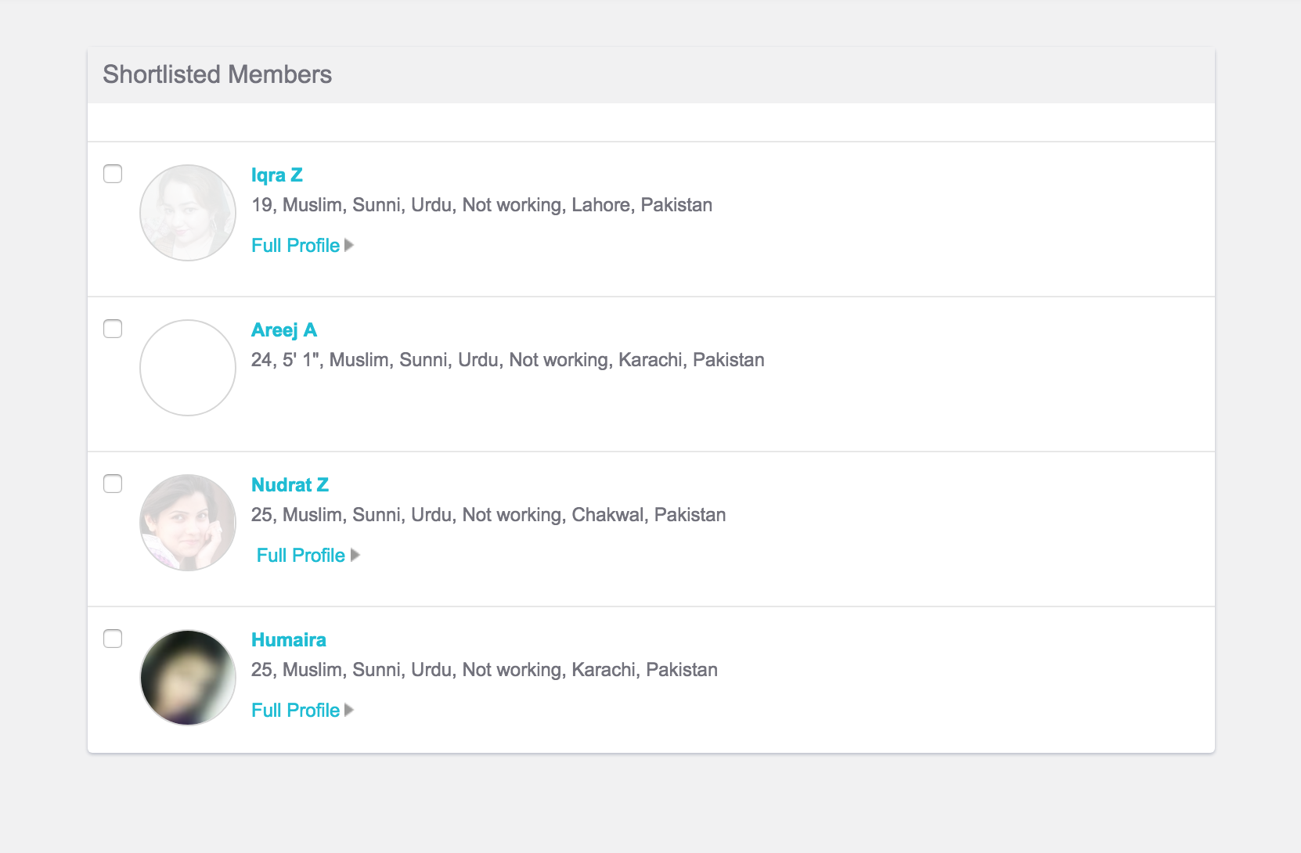

Slide 14
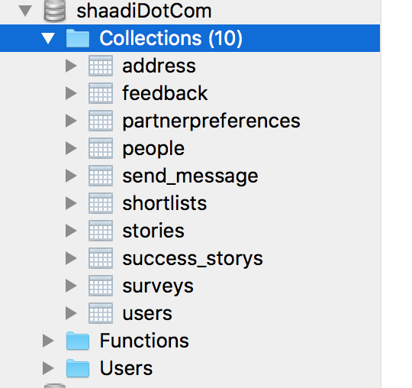
Backend Screen short:

Slide 15
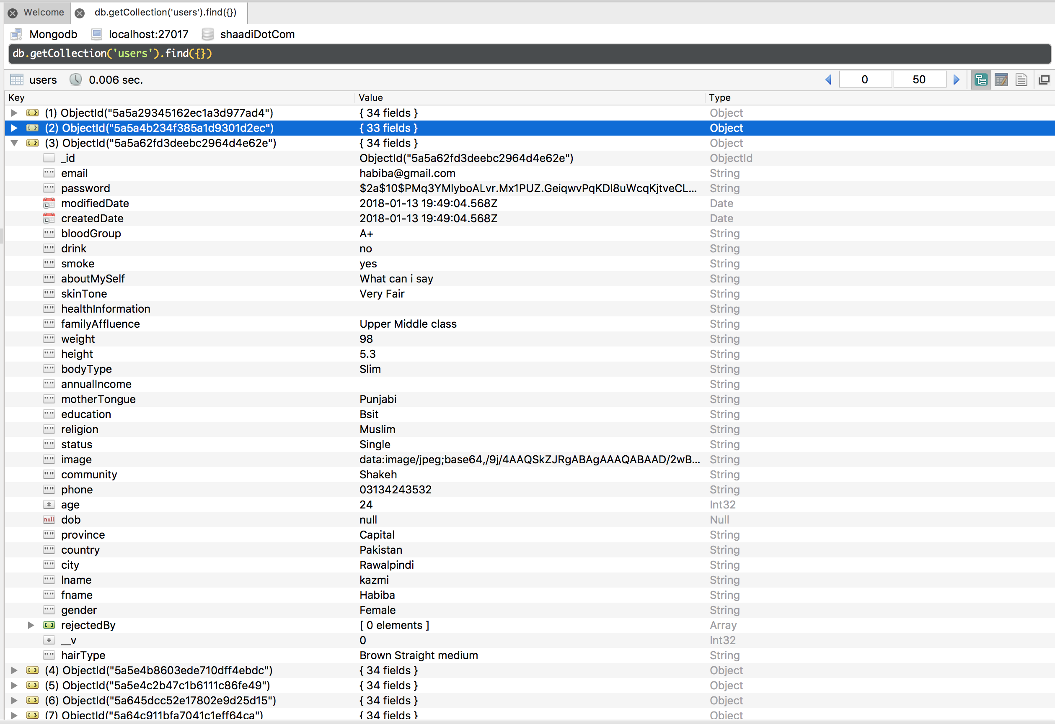

Slide 16
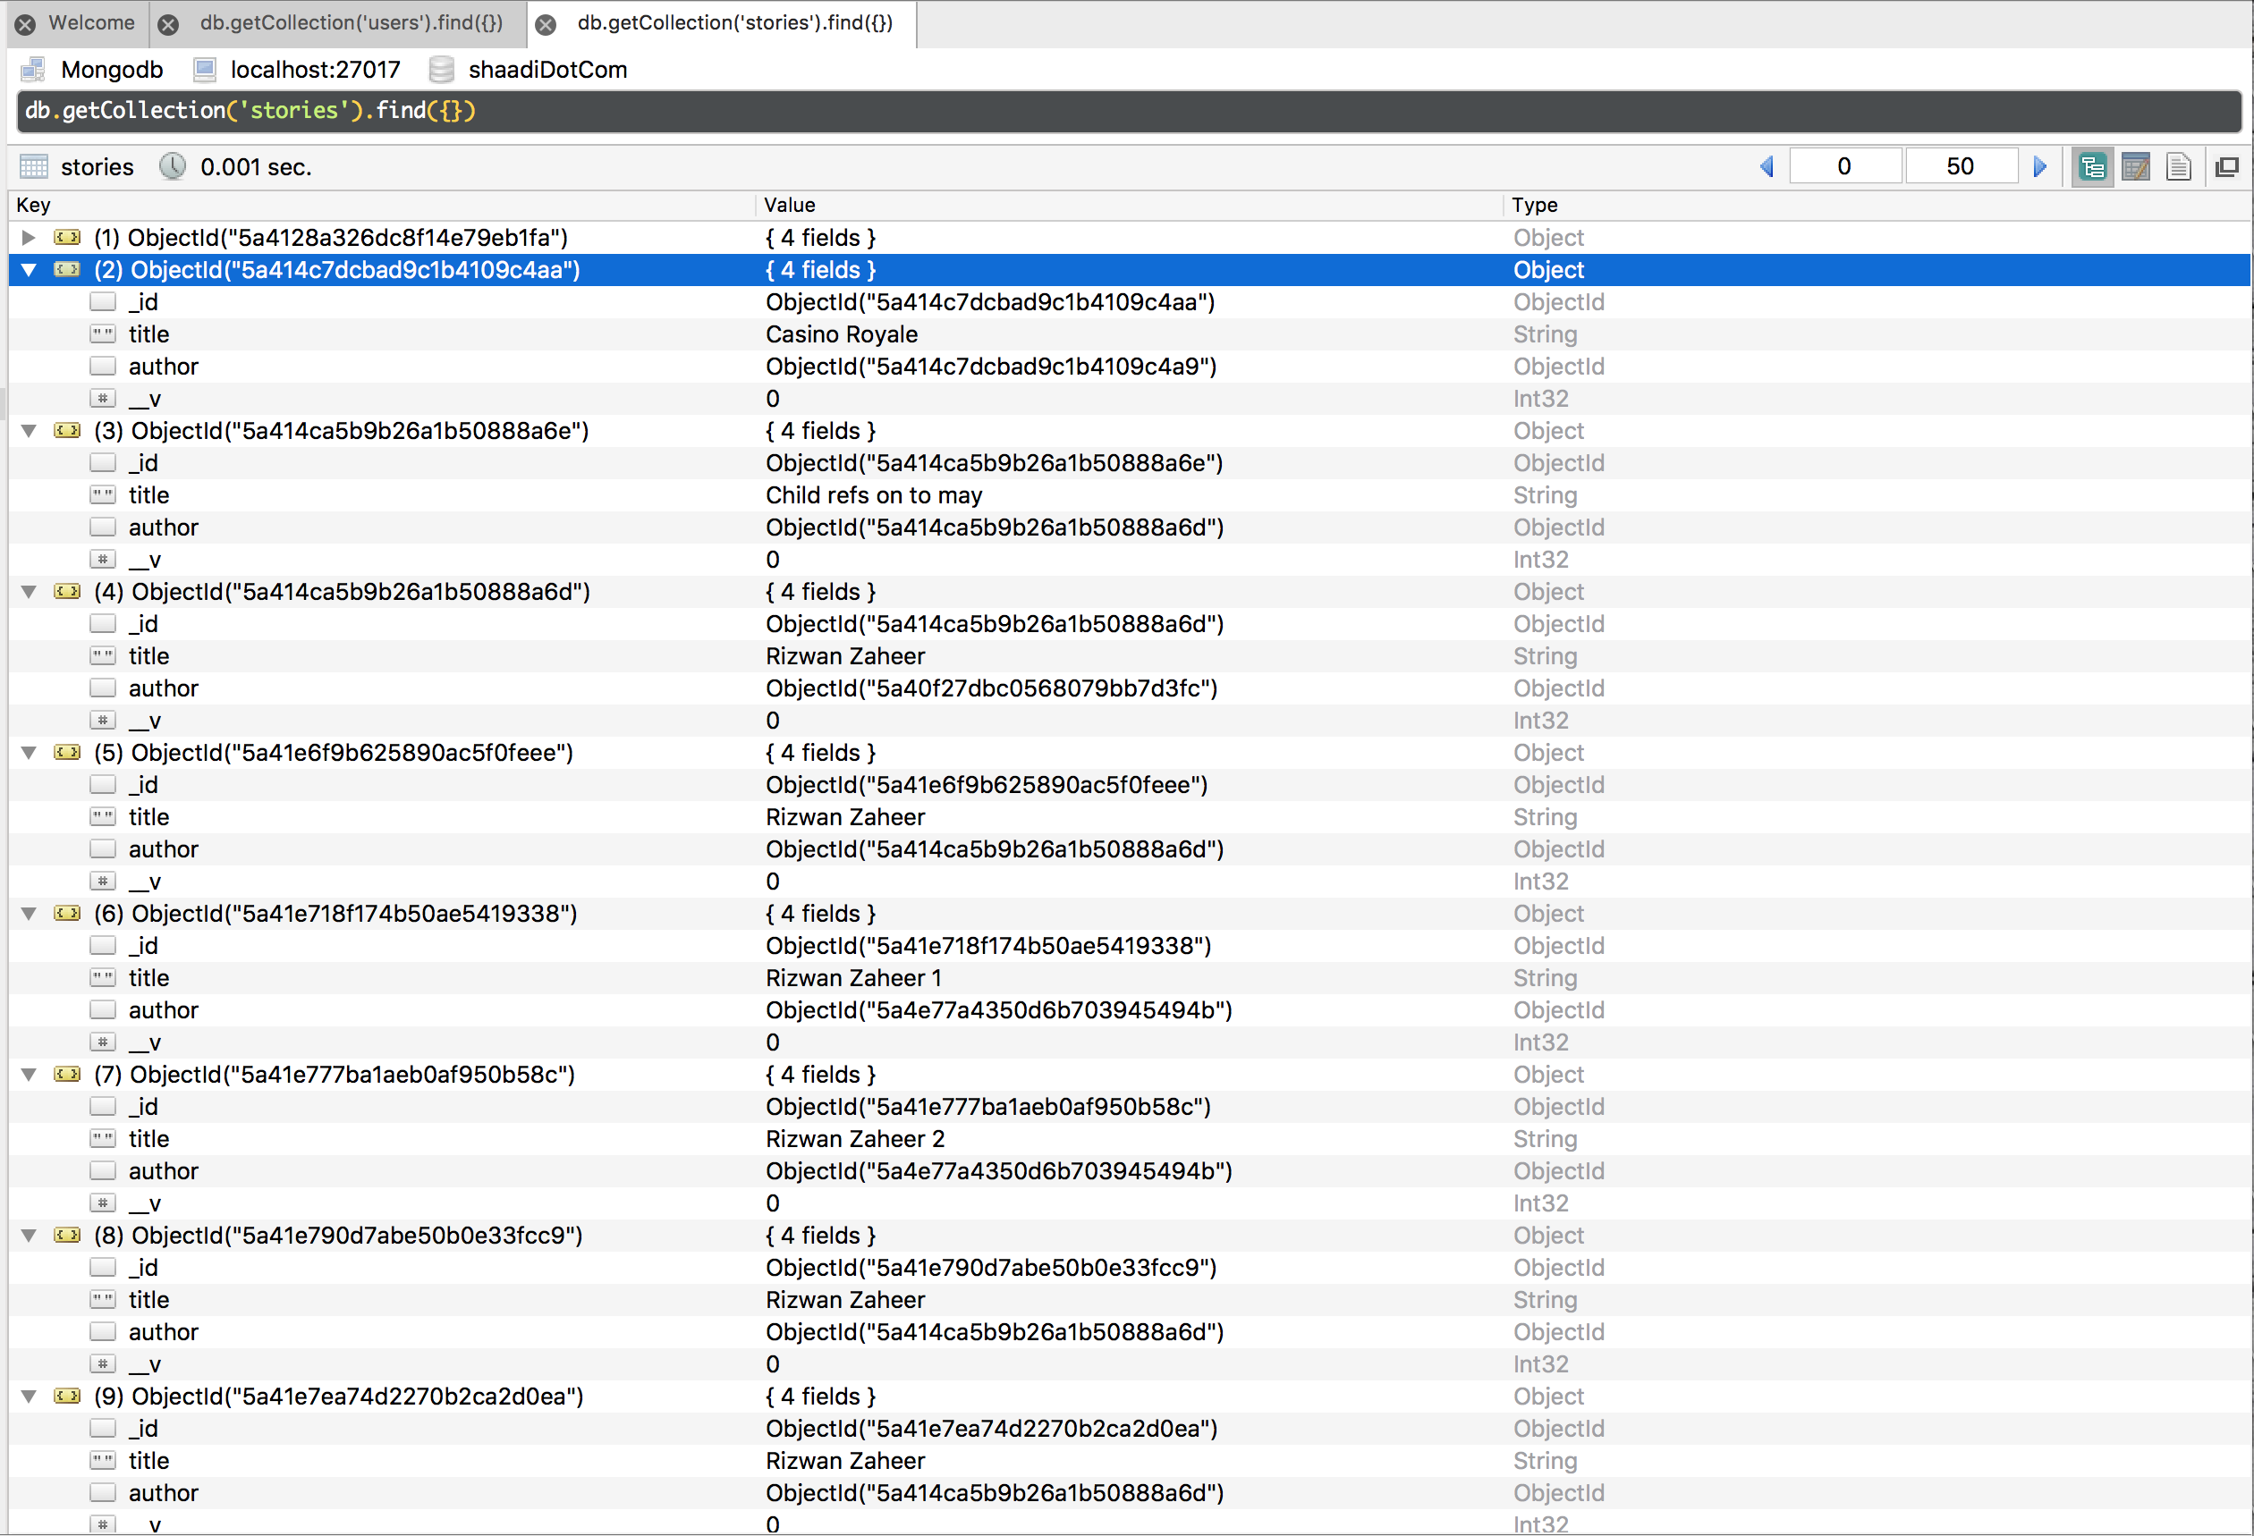

Slide 17
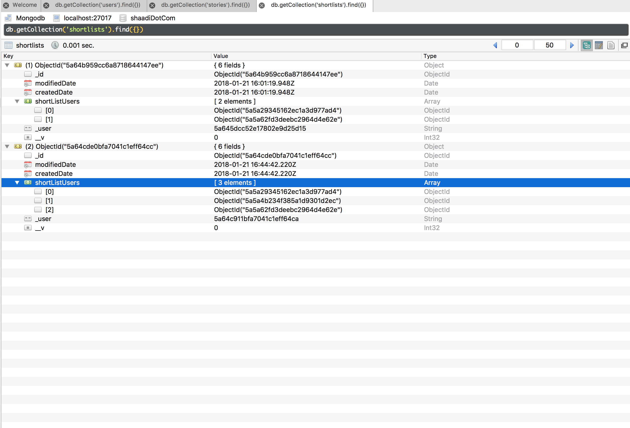

Slide 18
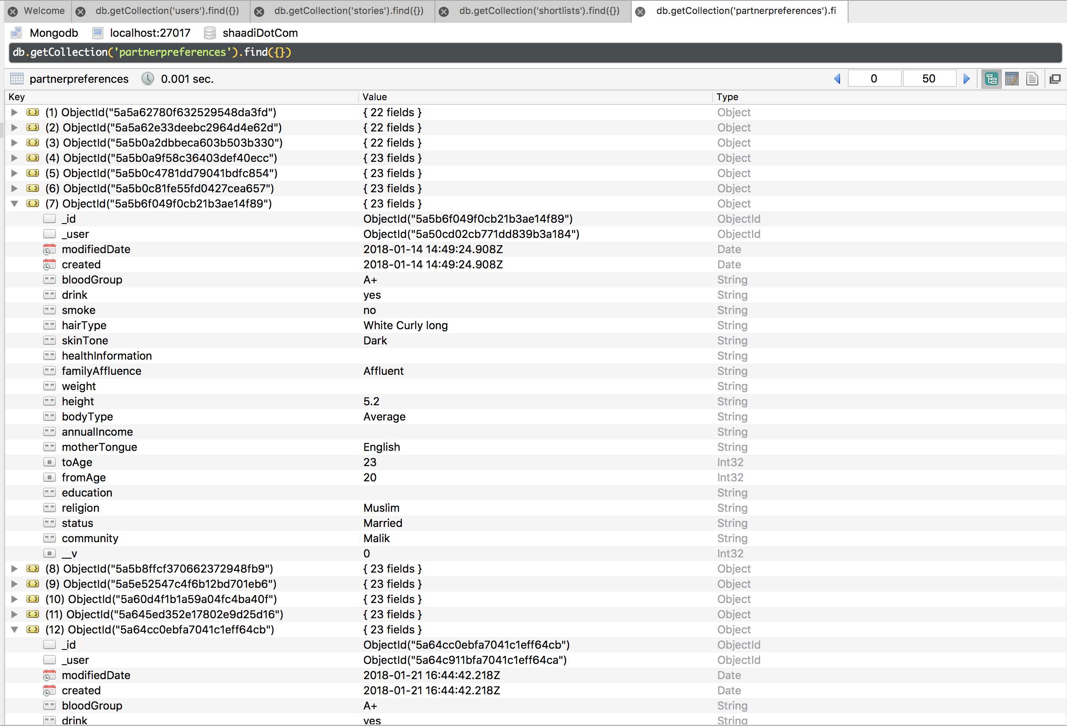

Slide 19
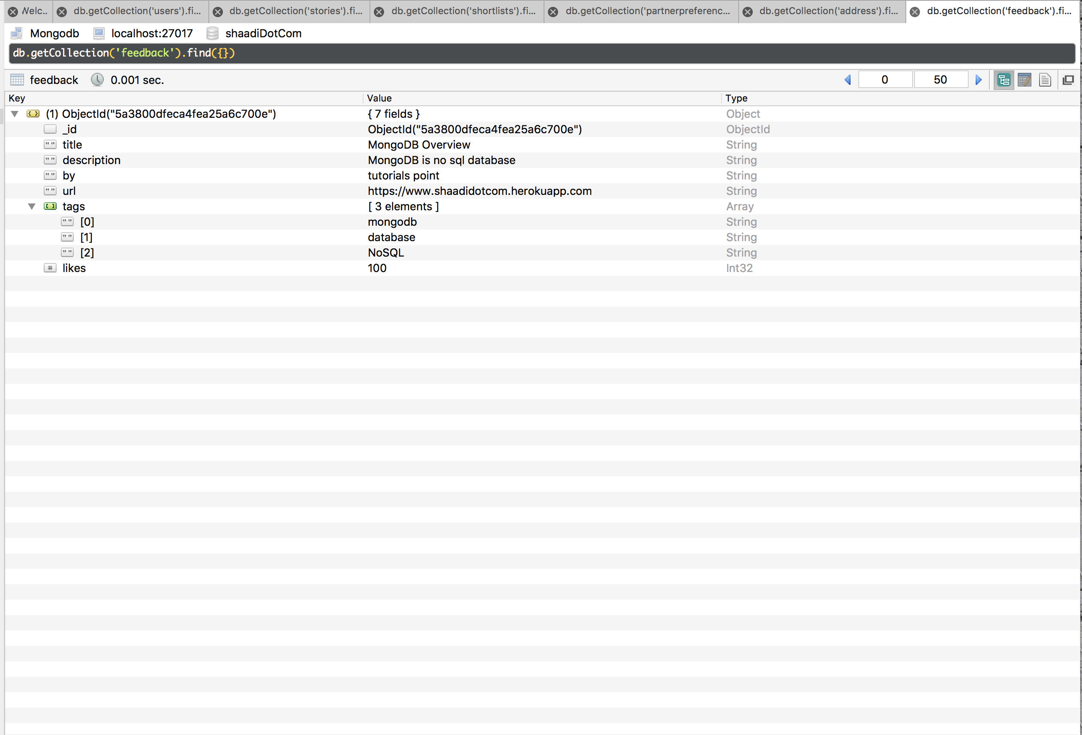

Slide 20
Features:
User can get information regarding their dream life partner.
The Bride/Groom can use match By Email functionality so he/she can get directly E-mail alert for the match which fulfill their required criteria.
This Application will be available for all devices who have internet/ Data package.

Slide 21
Tools & Technologies:
Visual Studio
Html5/Css3
ReactJs
NodeJs/ Expressjs
Mongodb(for Database)
Adobe Photoshop

Slide 23
Thanks You

Slide 24
Problem & Solution:
The problem & solution of the entitled project is for every user to use in their daily life for random to find the perfect life partner.
Matrimonial Web Application will allow a new user to register and after successfully registration user can get email confirmation and his/her profile will be visible to other users.
If any individual who want to use this App simply Enter the name on Google (shaadidotcom), simply open it and Good to go, After the search he can find the perfect match us.

